Slide 1
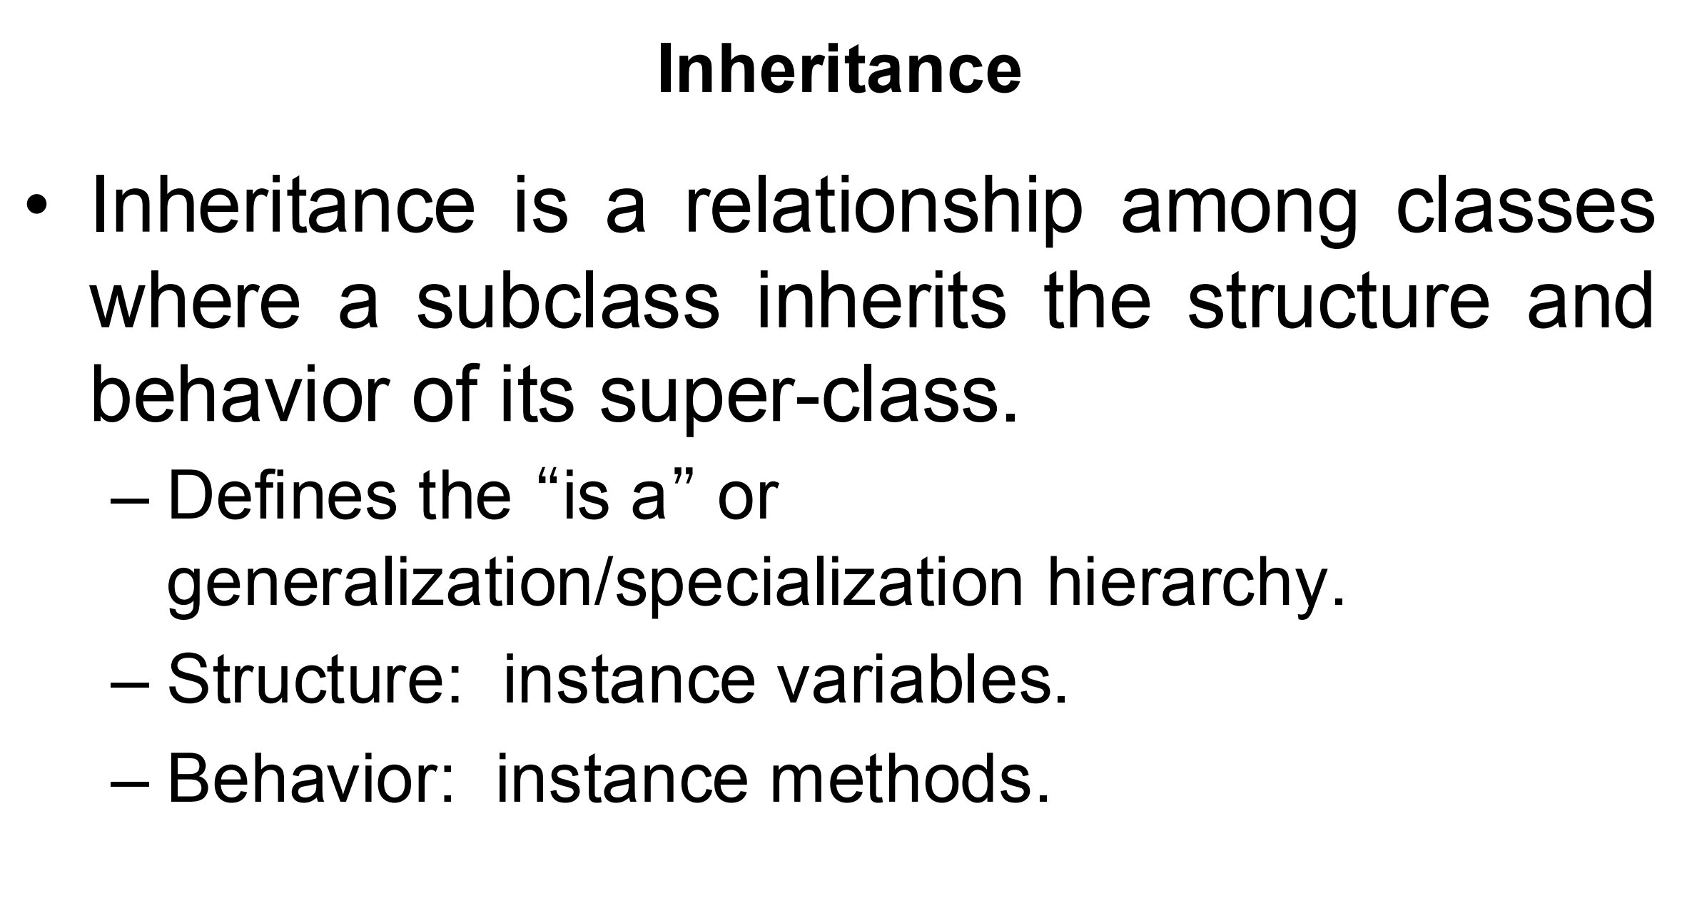

Slide 2
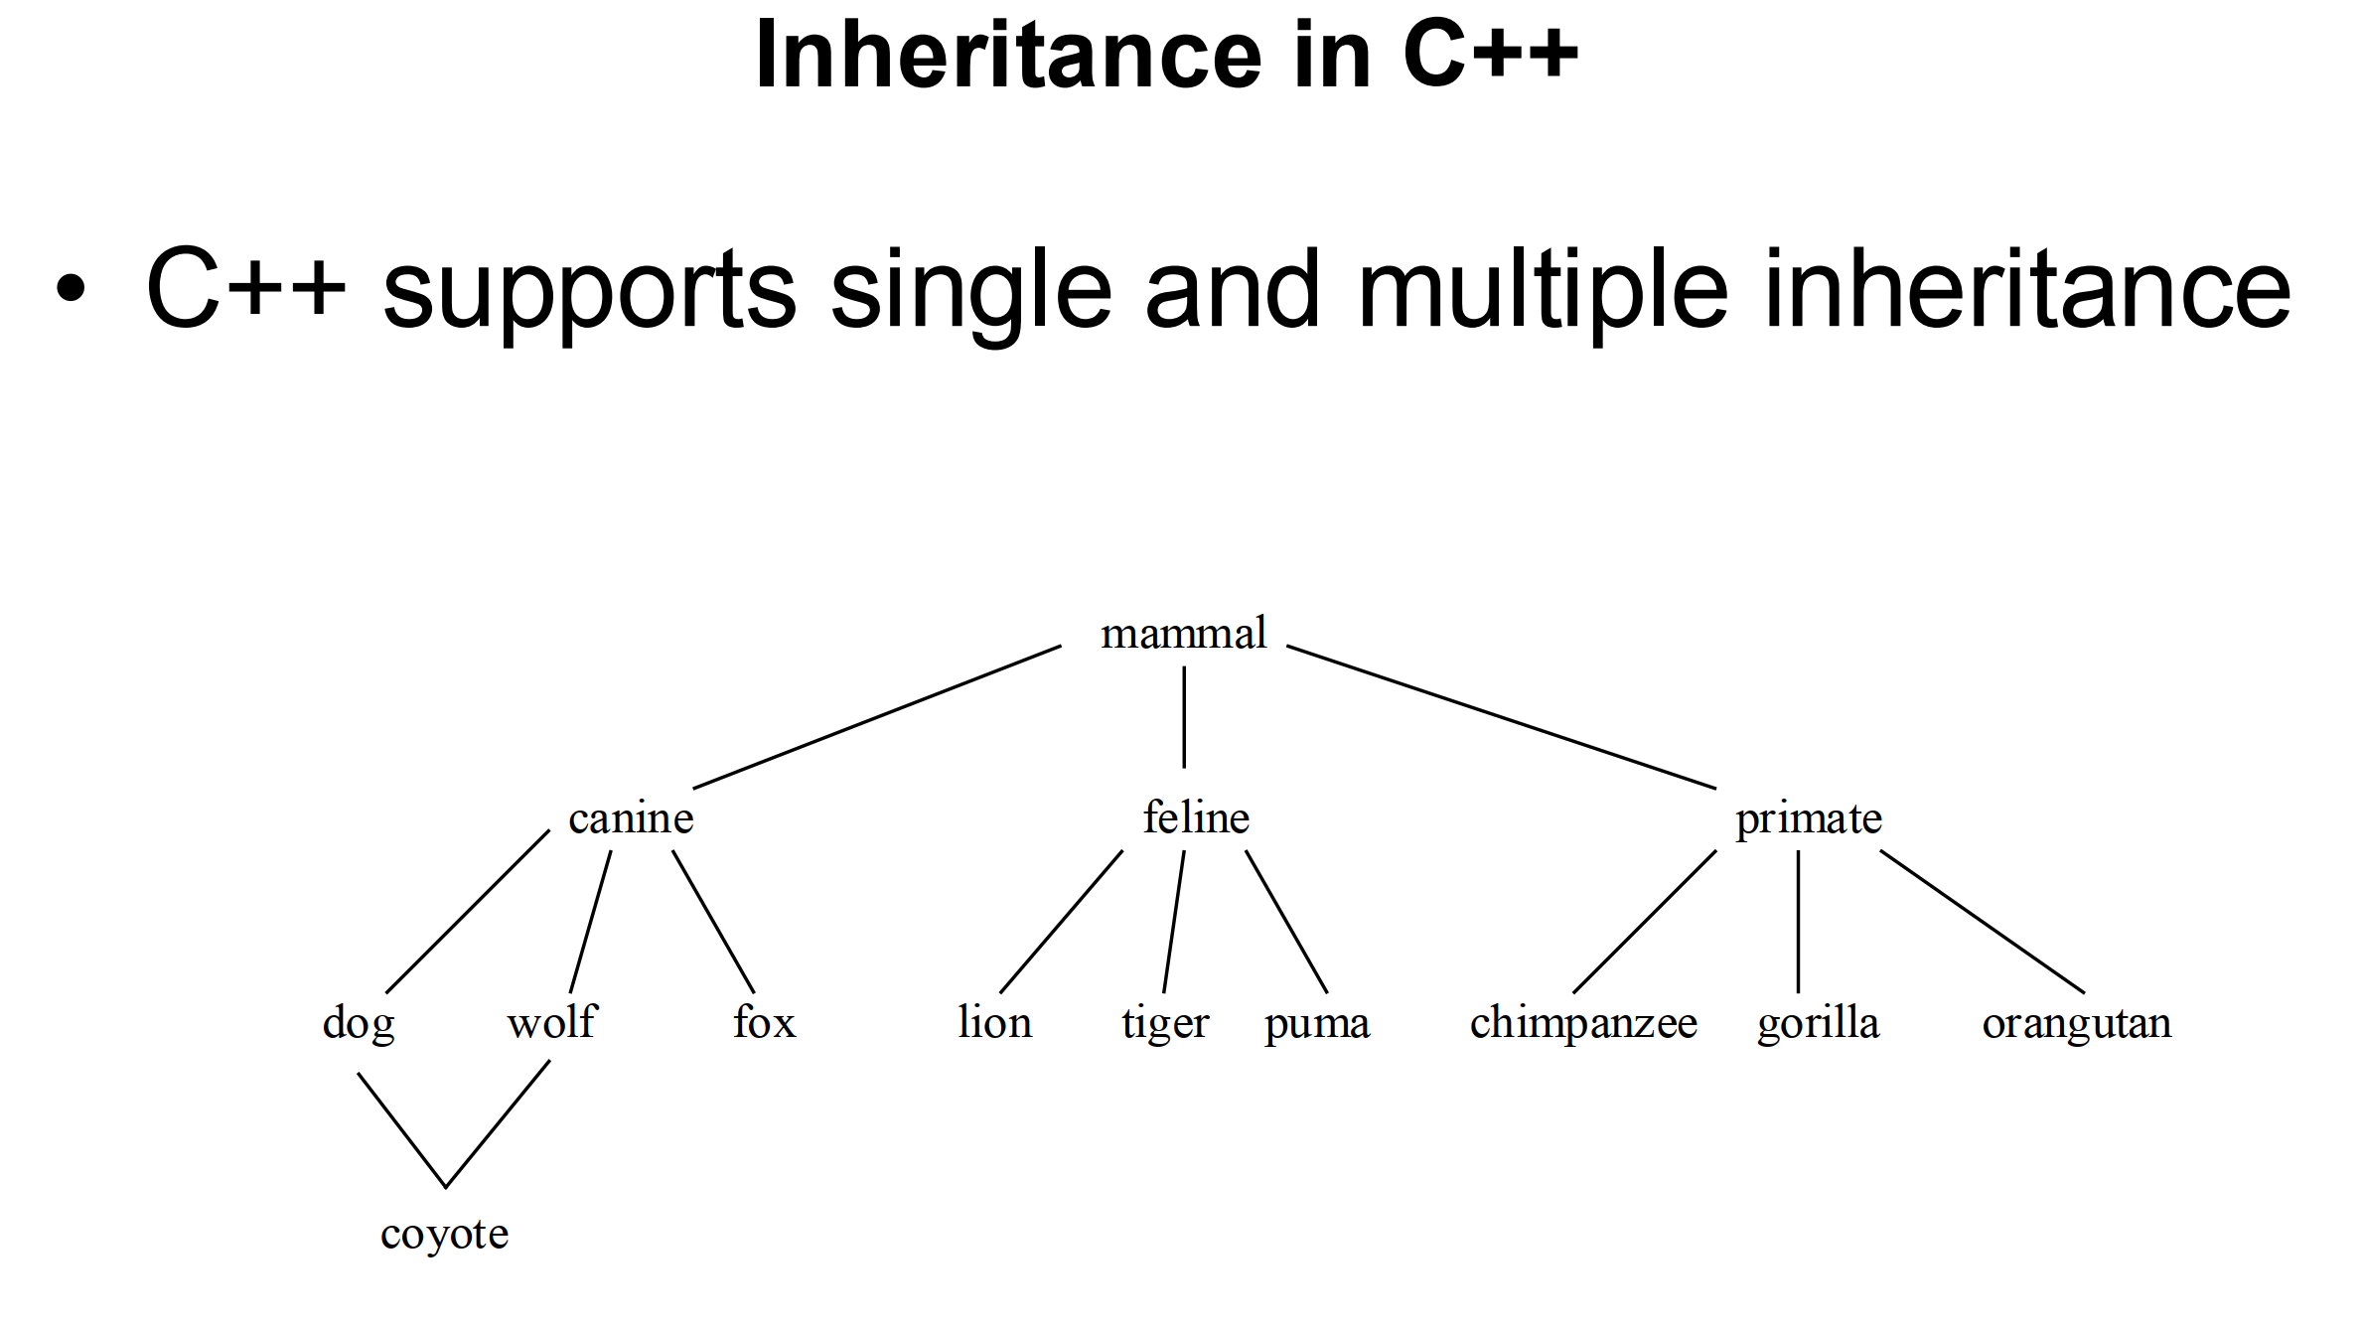

Slide 3
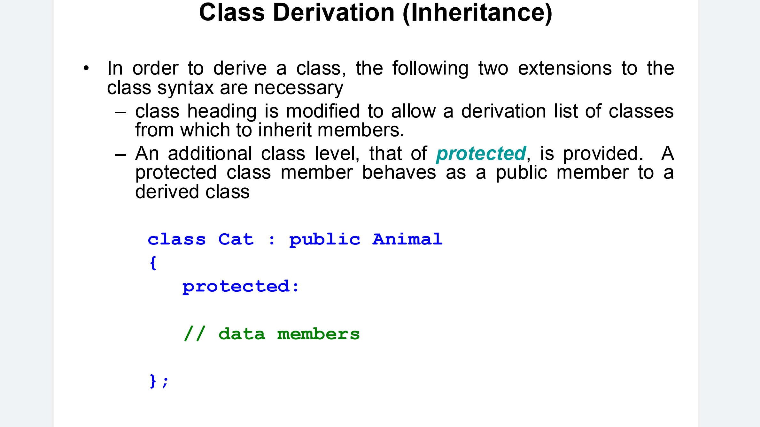

Slide 4
Deriving a Class
class DerivedClass : access_specifier BaseClass

Slide 5
Constructor and Destructor Behavior
class Base {
public:
Base() {
cout << "Base class constructor called" << endl;
}
~Base() {
cout << "Base class destructor called" << endl;
}
};
class Derived : public Base {
public:
Derived() {
cout << "Derived class constructor called" << endl;
}
~Derived() {
cout << "Derived class destructor called" << endl;
}
};
Base class constructor called
Derived class constructor called
Derived class destructor called
Base class destructor called
int main() {
Derived d; // Creating an object of Derived class
return 0;
}

Slide 6
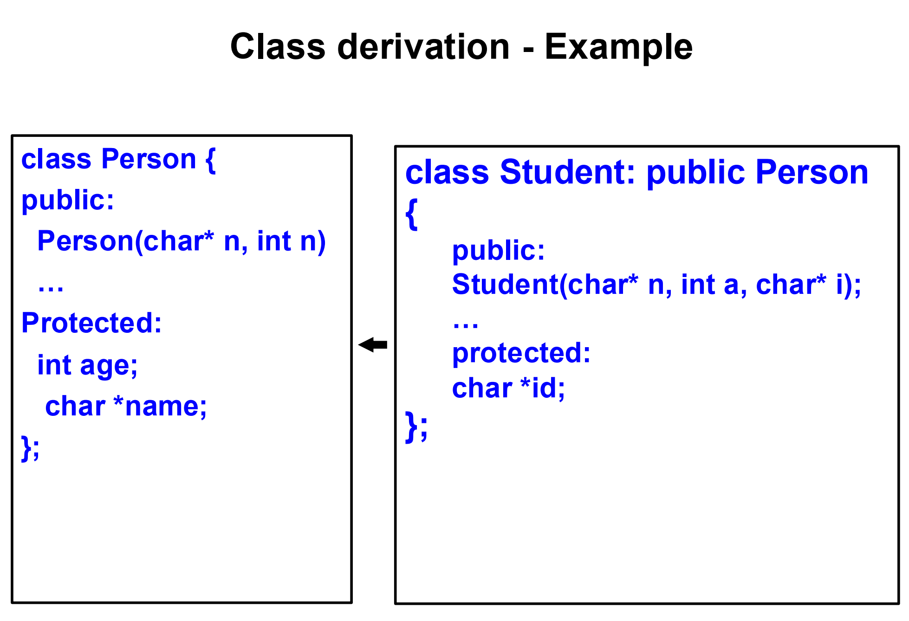
Student(char* n, int a, char* i) : Person(n, a)

Slide 7
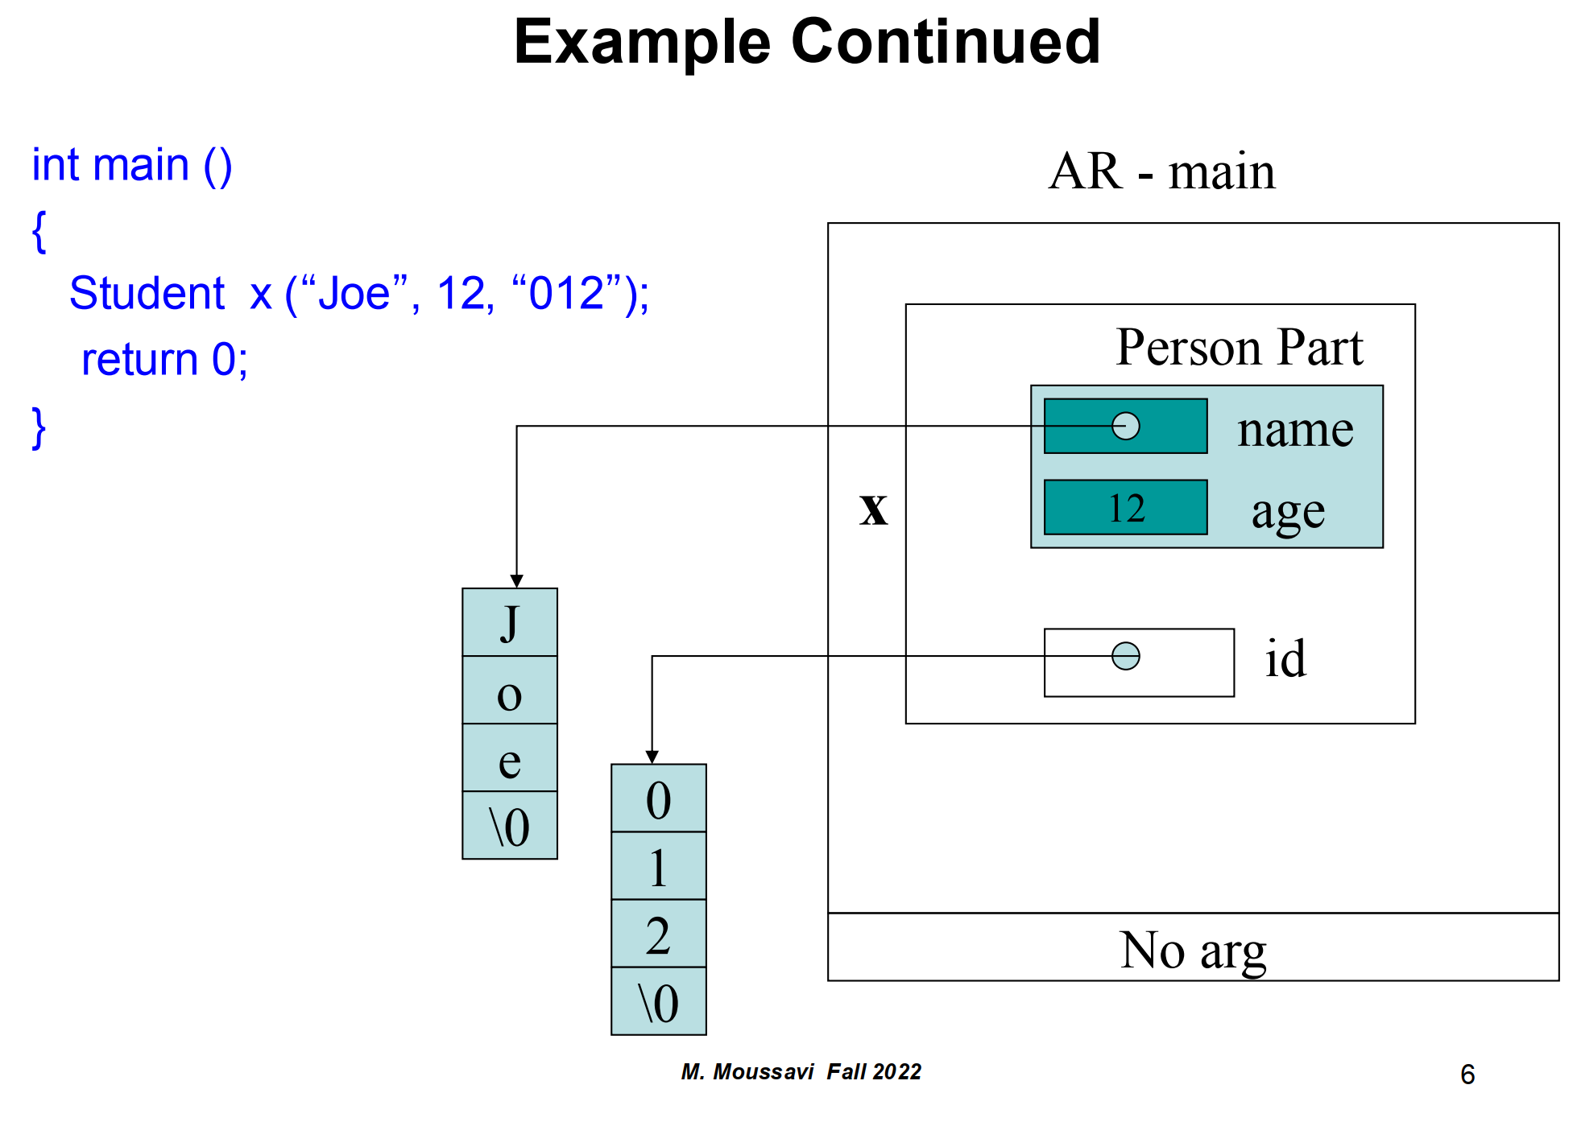

Slide 8
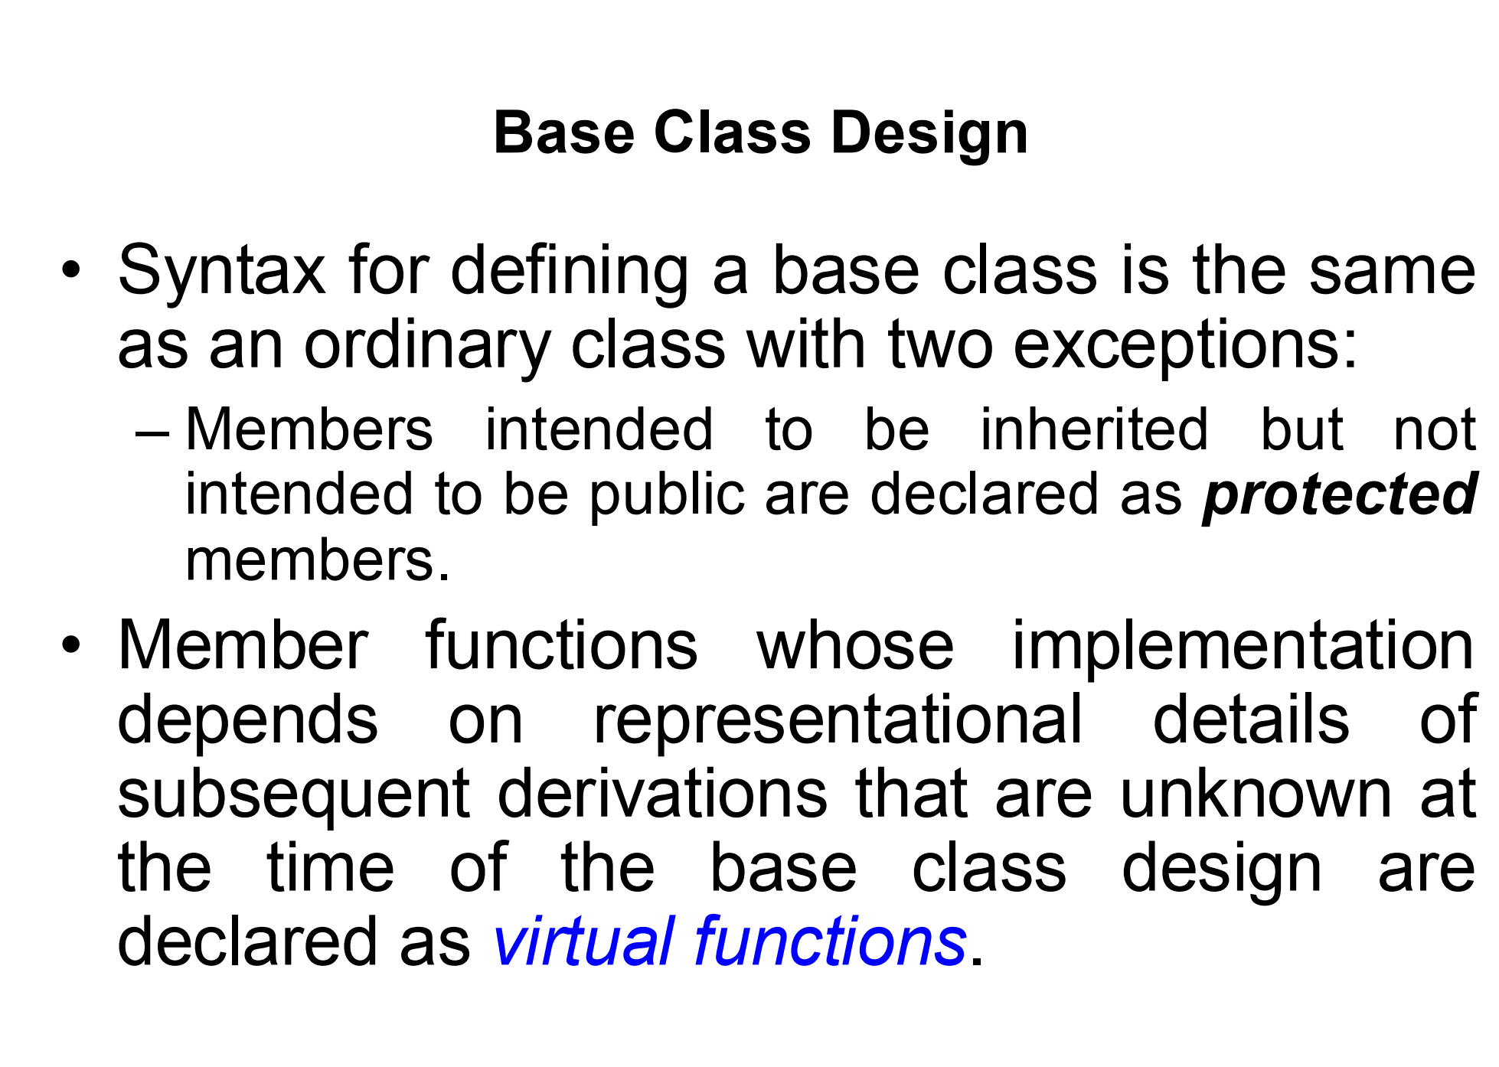

Slide 9
Protected
class Base {
protected:
int protectedData;
};
class Derived : public Base {
public:
void accessBaseData() {
// Can access protectedData because it's inherited as protected
protectedData = 10;
}
};

Slide 10
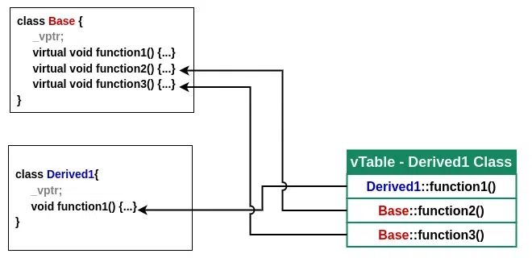
Virtual Functions
class Base {
public:
virtual void display() {
cout << "Display from Base" << endl;
}
};
class Derived : public Base {
public:
void display() override {
cout << "Display from Derived" << endl;
}
};
int main() {
Base* basePtr = new Derived();
basePtr->display(); // Calls Derived's display() due to virtual function
delete basePtr;
}

Slide 11
Why Virtual Functions are Useful
Dynamic Behavior
Base Class Design Strategy

Slide 12
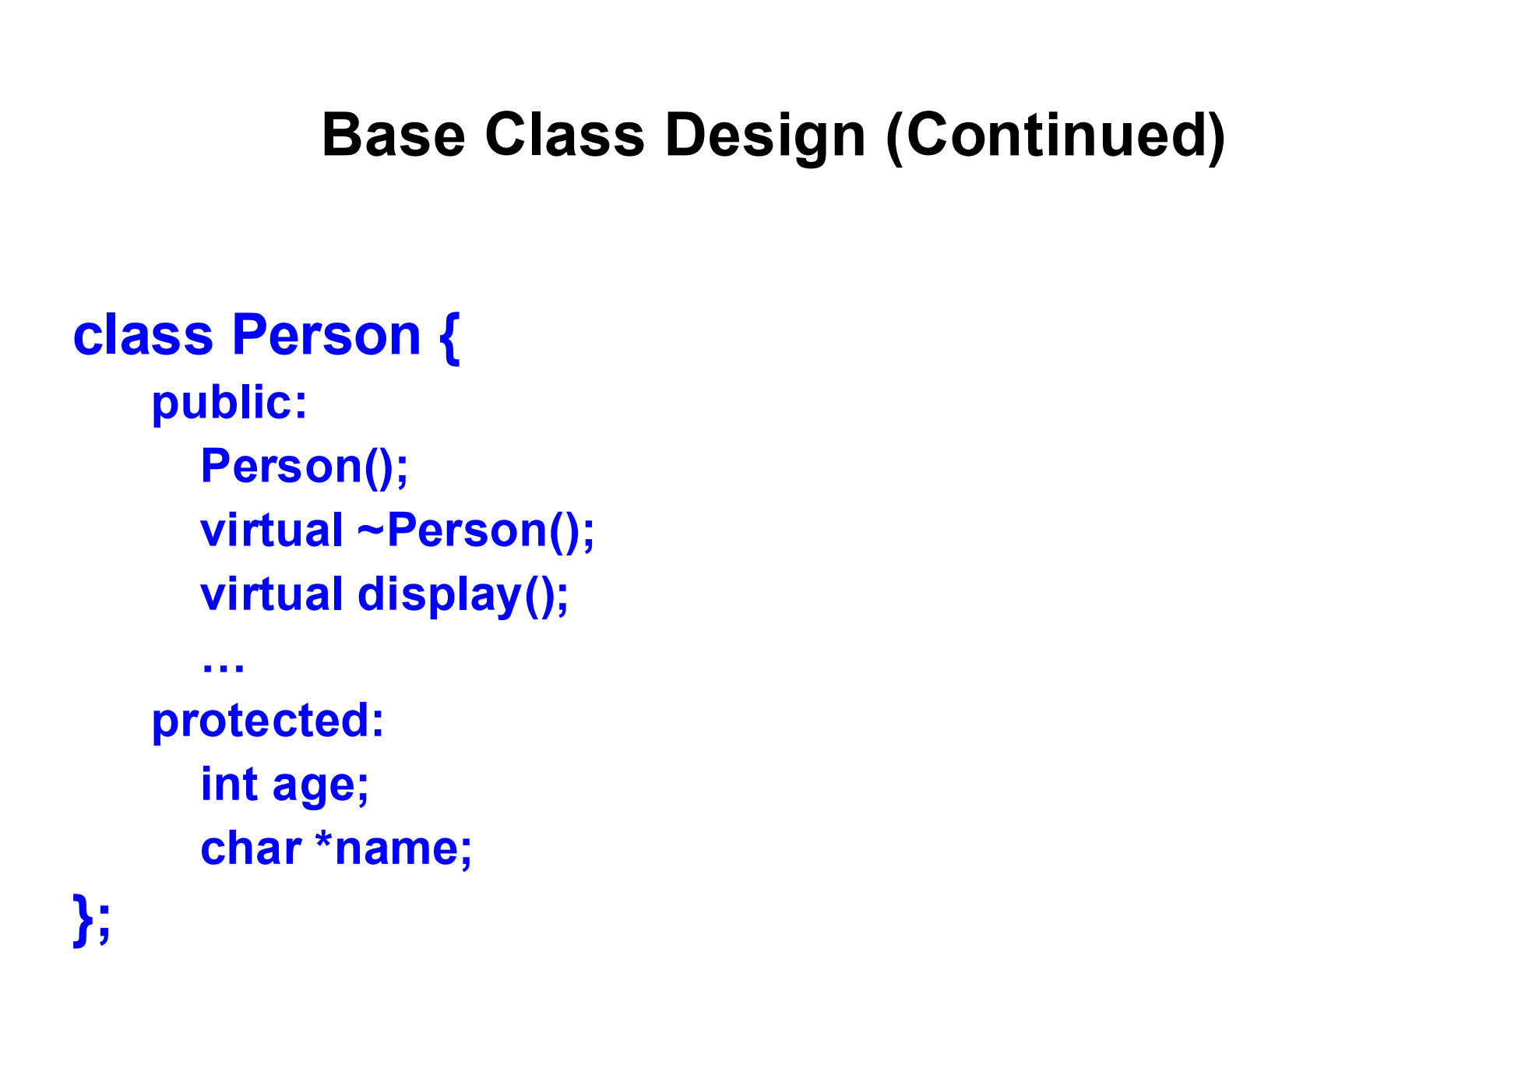
class Student : public Person {
public:
Student();
~Student(); // Destructor of Student class
void display(); // Overriding display function from Person class
private:
int studentID; // Additional data member specific to Student
};
Person* person = new Student(); // Student is a class derived from Person
delete person; // If ~Person() is not virtual, Student's destructor won't be called!

Slide 13
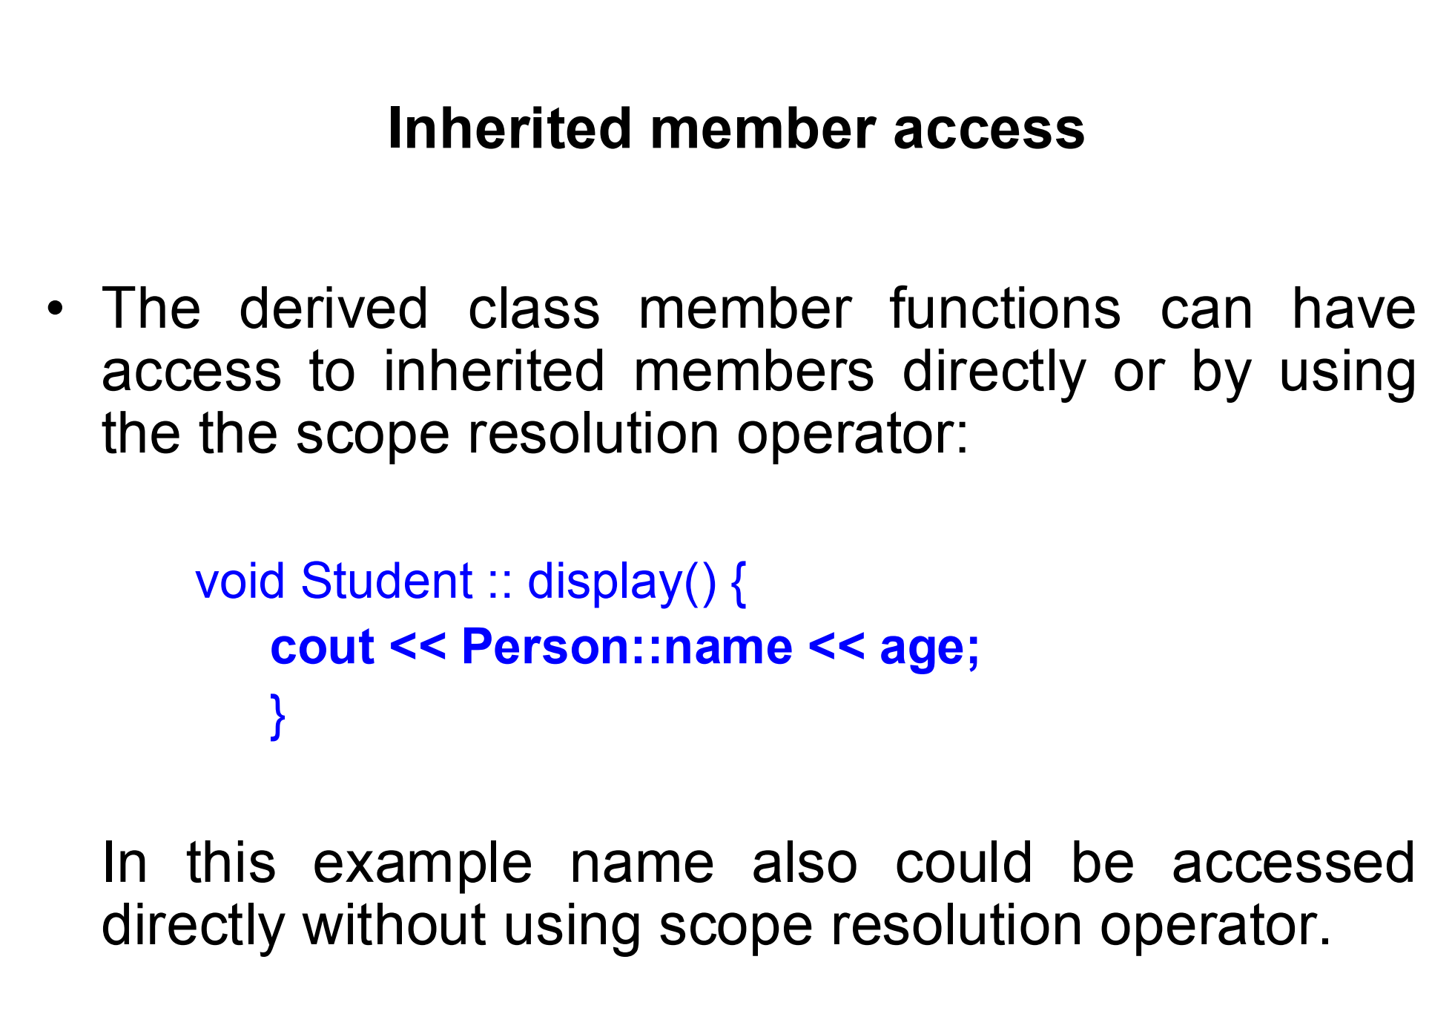
void Student::display() {
cout << name << " " << age; // Direct access to name and age
}

Slide 14
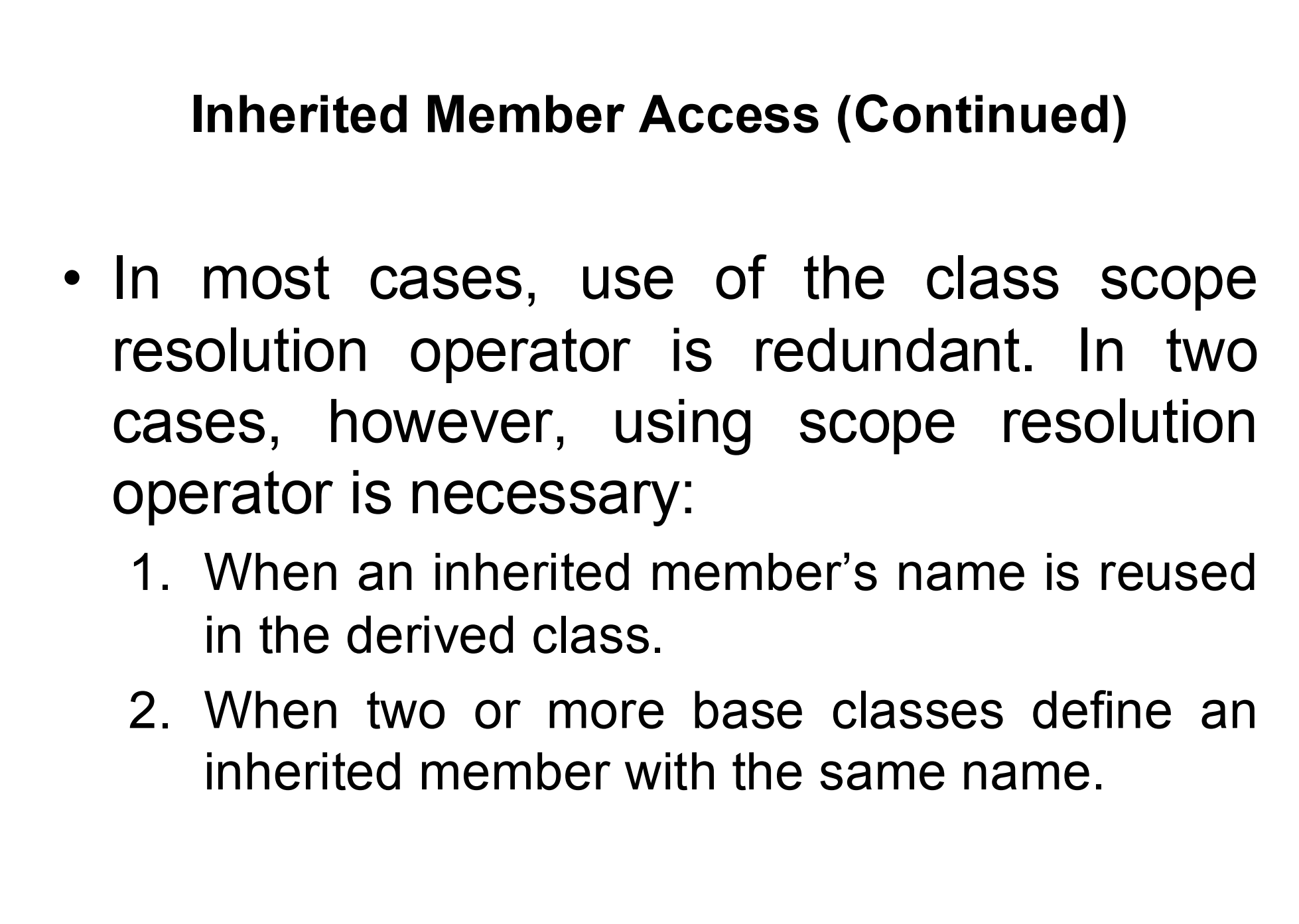

Slide 15
Case 1: When an Inherited Member’s Name is Reused in the Derived Class:
class Person {
protected:
char* name;
};
class Student : public Person {
protected:
char* name; // This hides Person::name
public:
void showName() {
cout << Person::name; // Use scope resolution to access Person::name
cout << name; // Access the Student::name
}
};

Slide 16
Case 2: When Two or More Base Classes Define an Inherited Member with the Same Name
class Teacher {
protected:
int id;
};
class Admin {
protected:
int id;
};
class Principal : public Teacher, public Admin {
public:
void showID() {
cout << Teacher::id; // Access Teacher's id
cout << Admin::id; // Access Admin's id
}
};

Slide 17
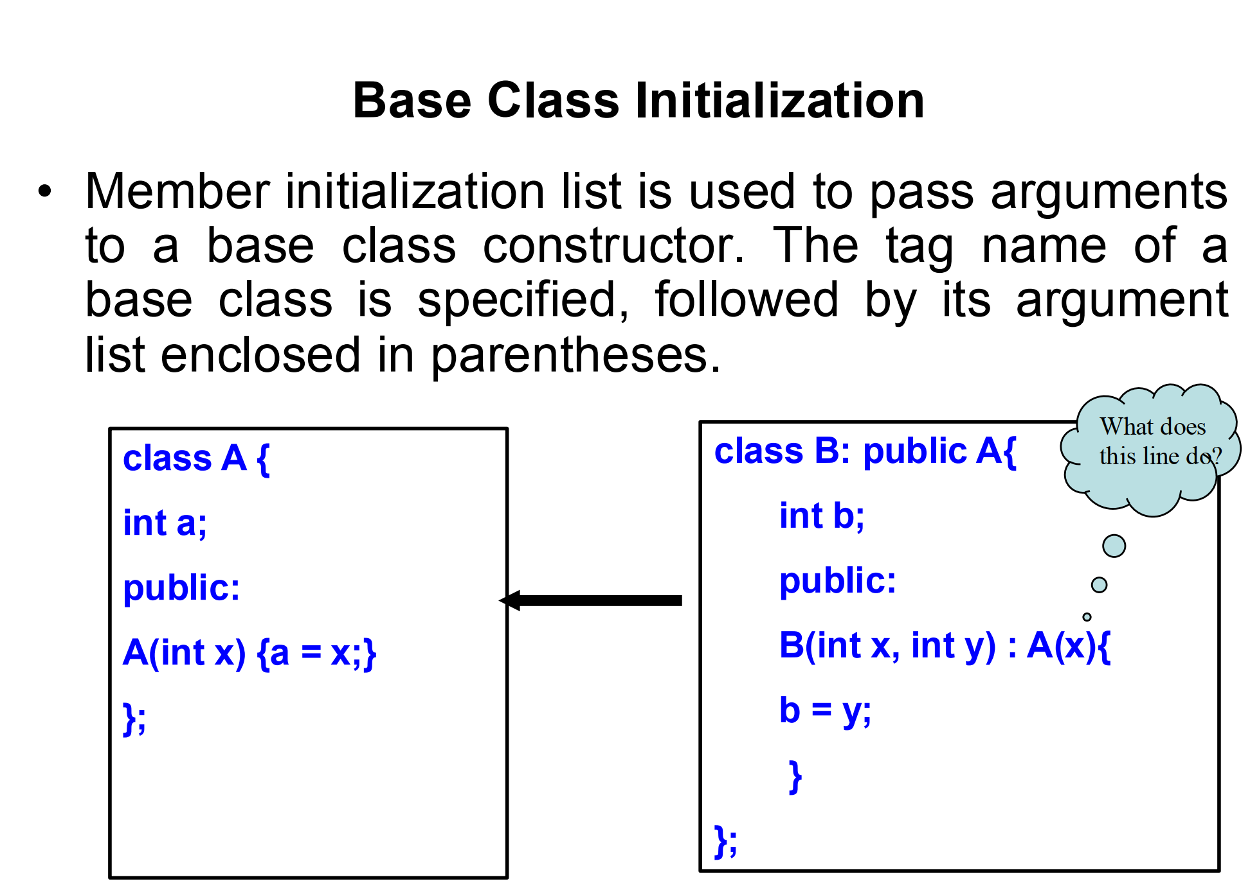

Slide 18
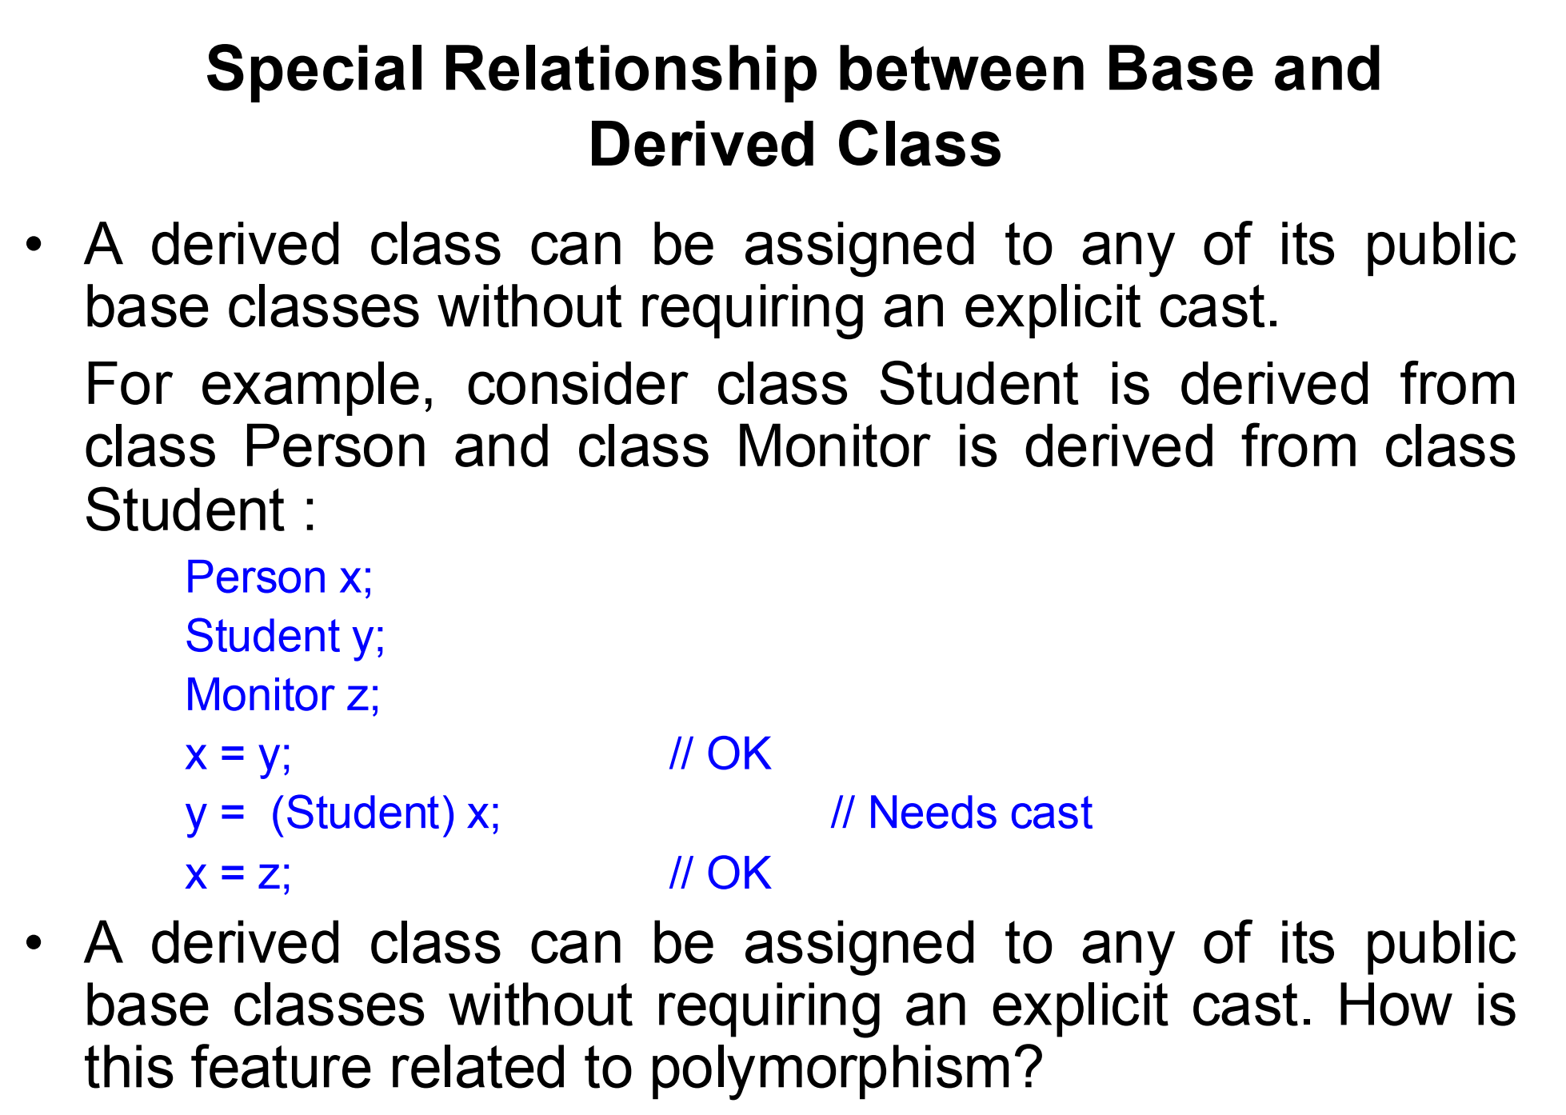

Slide 19
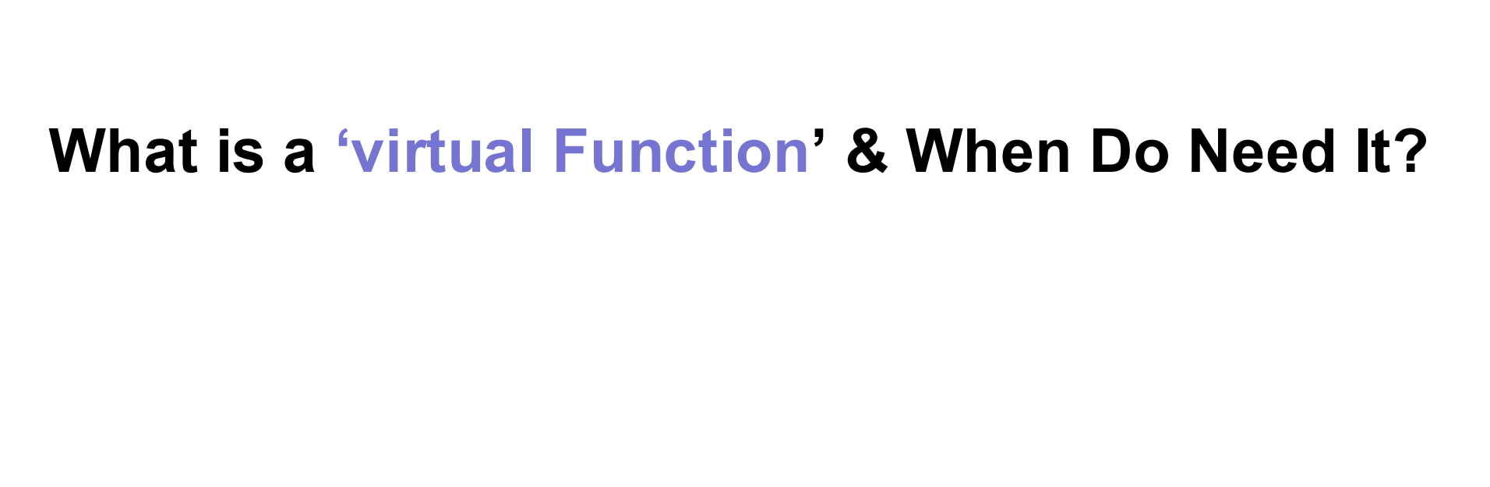

Slide 20
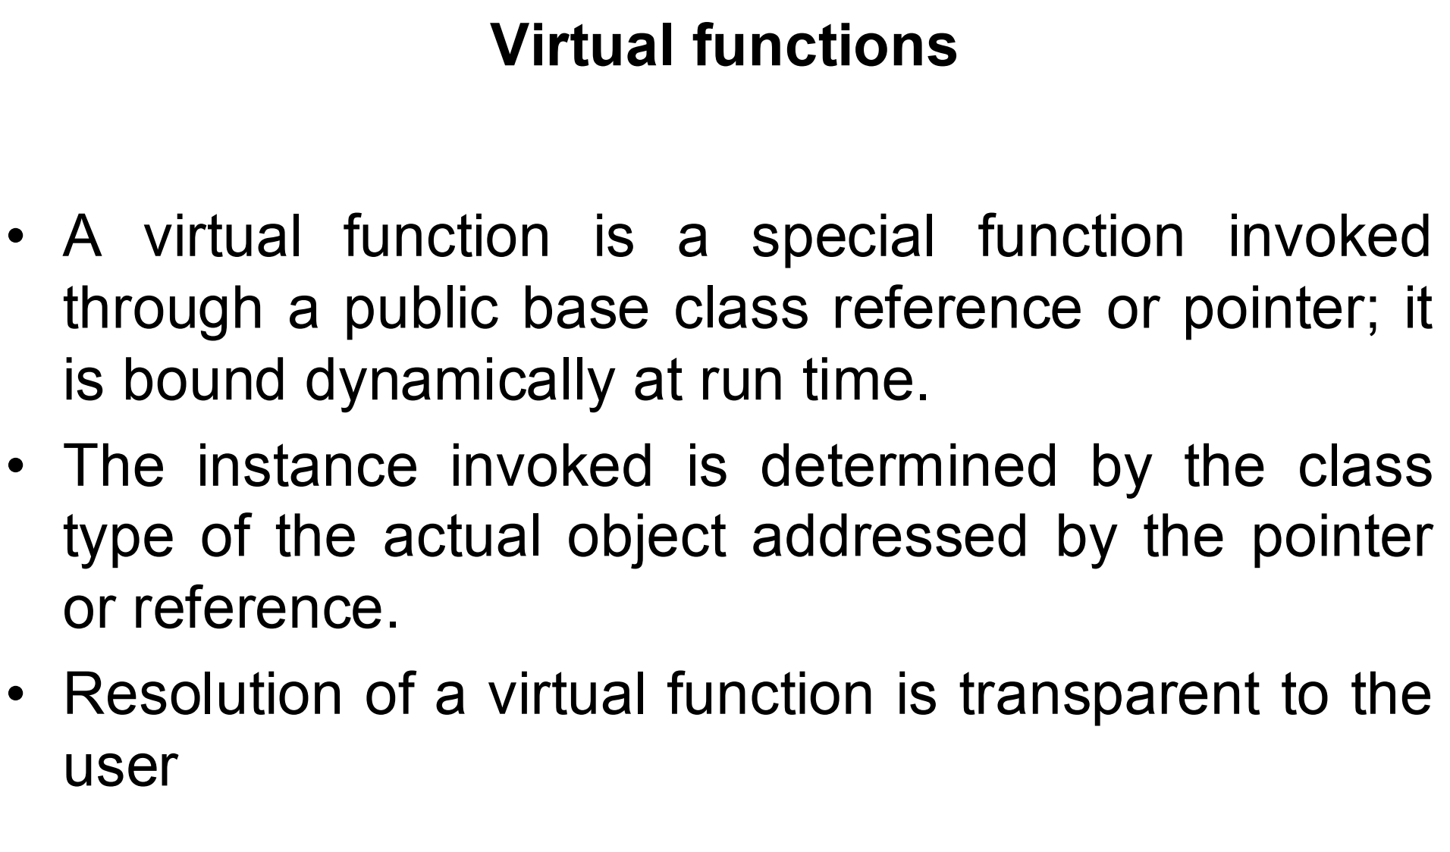

Slide 21
Instance Determination
class TVRemote {
public:
virtual void pressPower() { cout << "Turning on the regular TV" << endl; }
};
class SmartTVRemote : public TVRemote {
public:
void pressPower() override { cout << "Turning on the Smart TV and showing apps" << endl; }
};
TVRemote* remotePtr = new SmartTVRemote();
remotePtr->pressPower(); // Calls SmartTVRemote::pressPower() because remotePtr points to a SmartTVRemote object

Slide 22
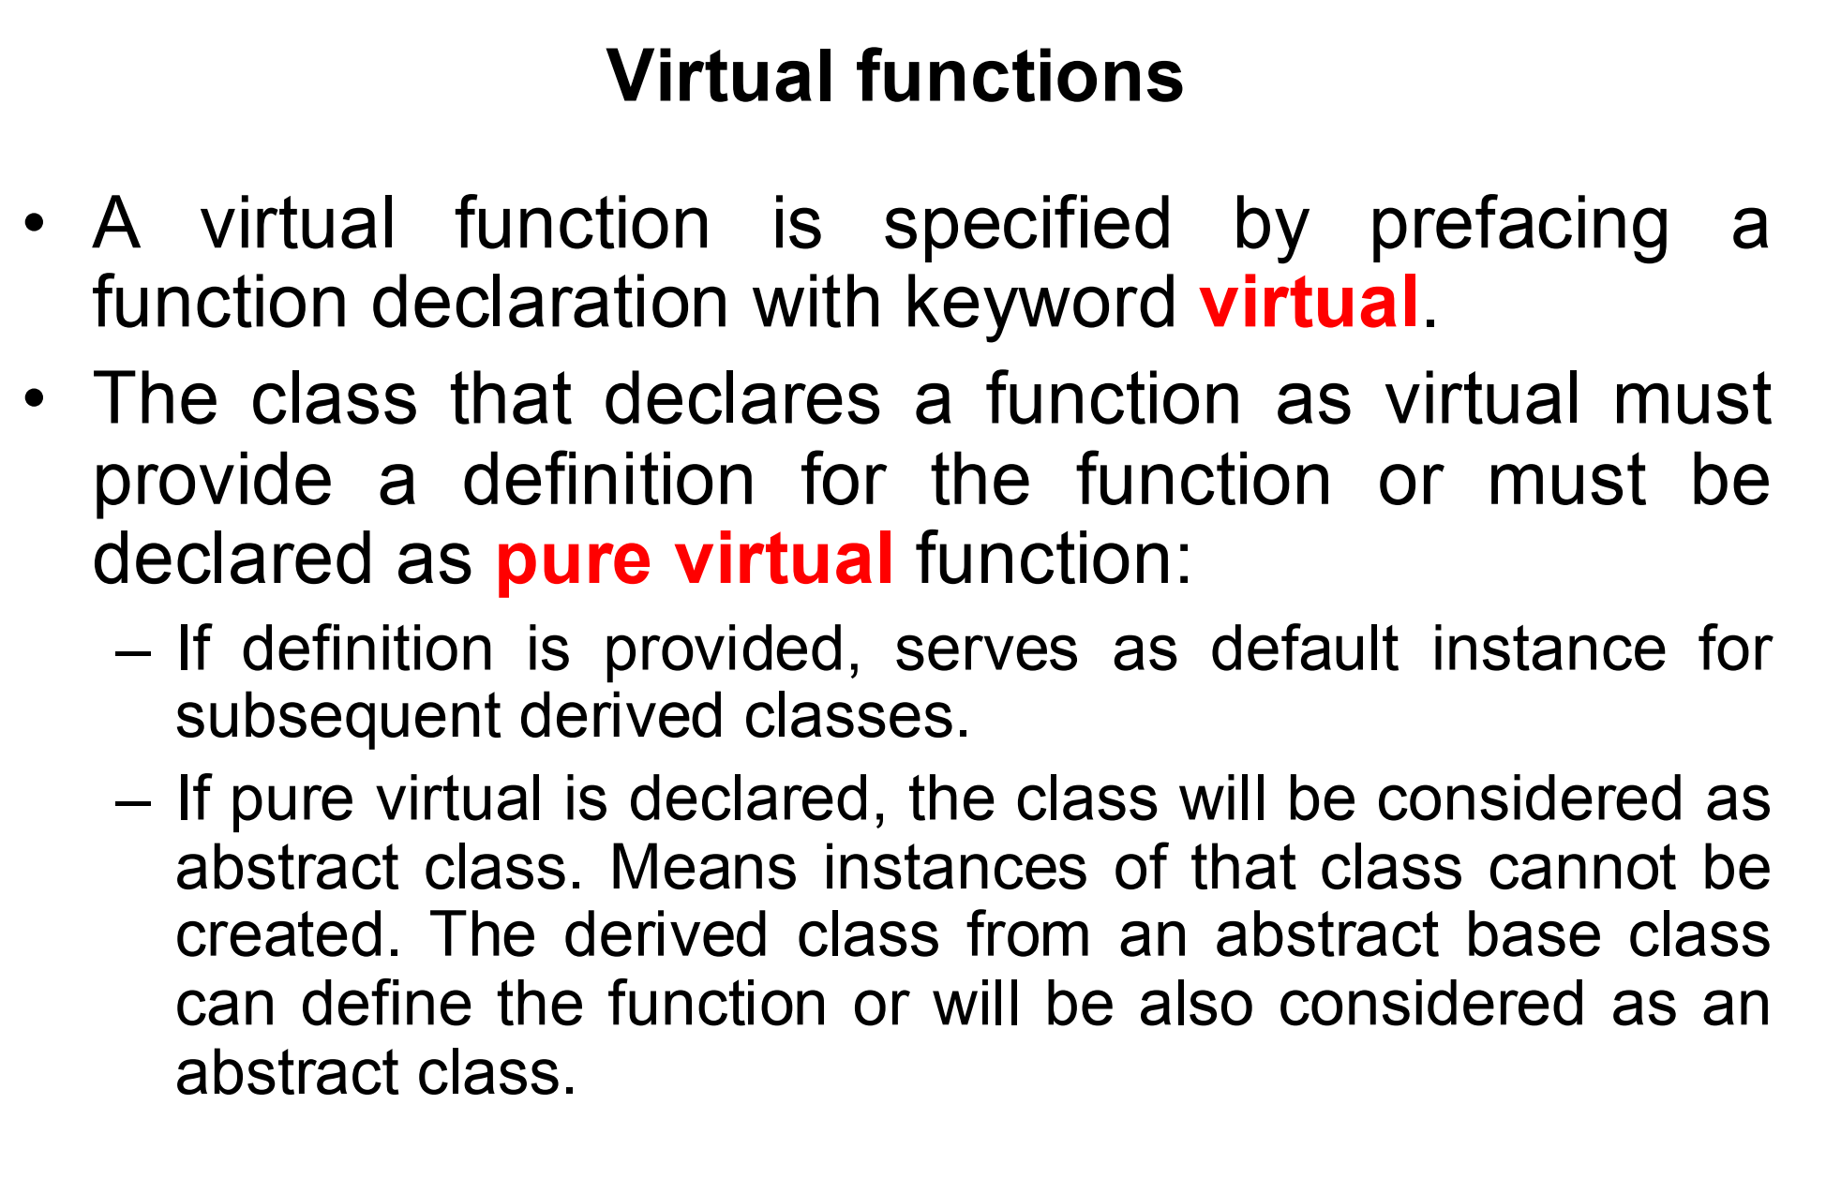

Slide 23
Providing a Definition for Virtual Functions
class Base {
public:
virtual void show() { cout << "Base class show" << endl; } // Default implementation
};
class Derived : public Base {
// No overriding of 'show', so Base::show() will be used.
};

Slide 24
Pure Virtual Functions and Abstract Classes
class Base {
public:
virtual void show() = 0; // Pure virtual function
};
Base obj; // This will cause an error because Base is an abstract class.

Slide 25
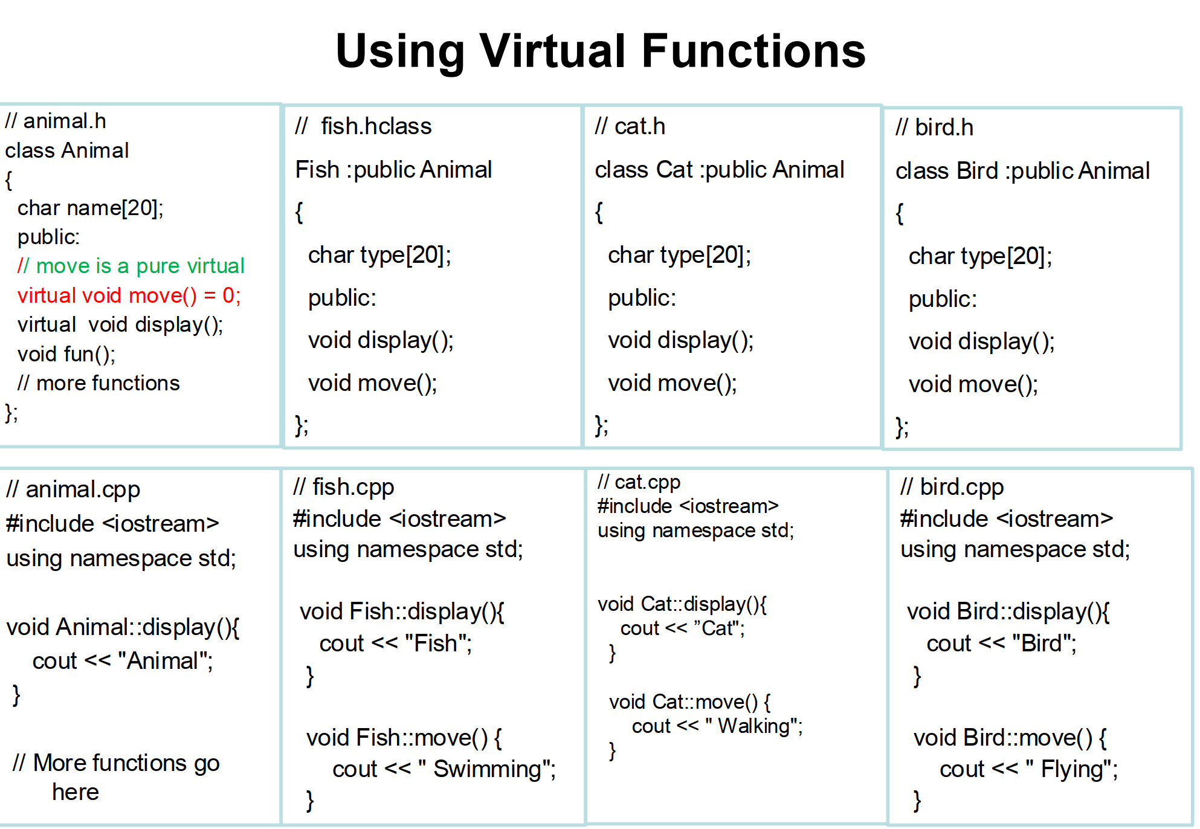
Animal* animalPtr;
Fish fish;
Cat cat;
Bird bird;
animalPtr = &fish;
animalPtr->display(); // Output: Fish
animalPtr->move(); // Output: Swimming
animalPtr = &cat;
animalPtr->display(); // Output: Cat
animalPtr->move(); // Output: Walking
animalPtr = &bird;
animalPtr->display(); // Output: Bird
animalPtr->move(); // Output: Flying

Slide 26
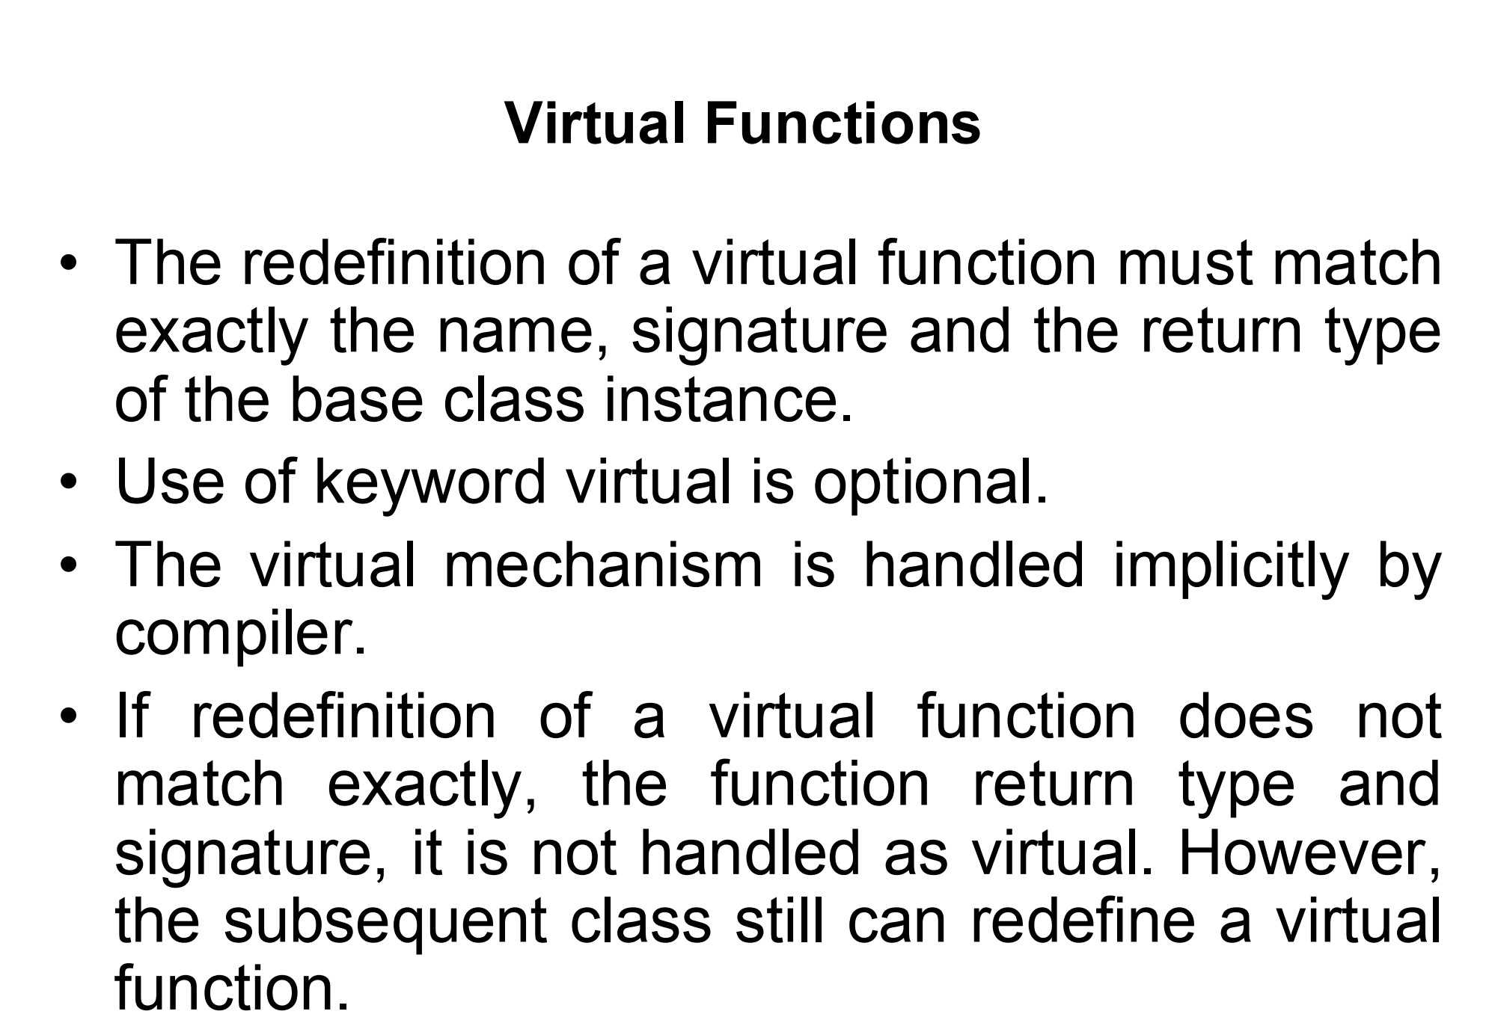
virtual void show(int a);
void show(); // This will not be treated as a virtual function override

Slide 27
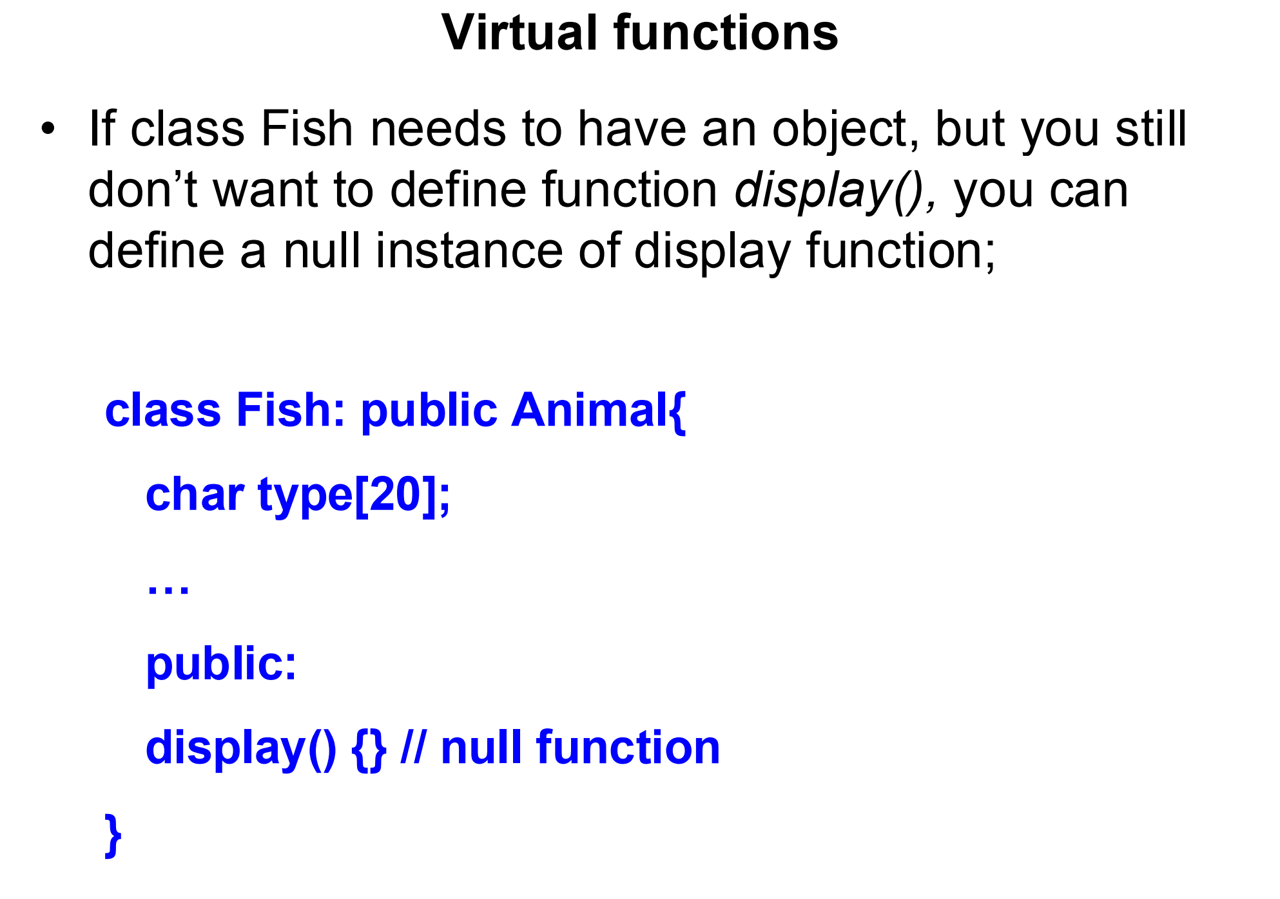

Slide 28
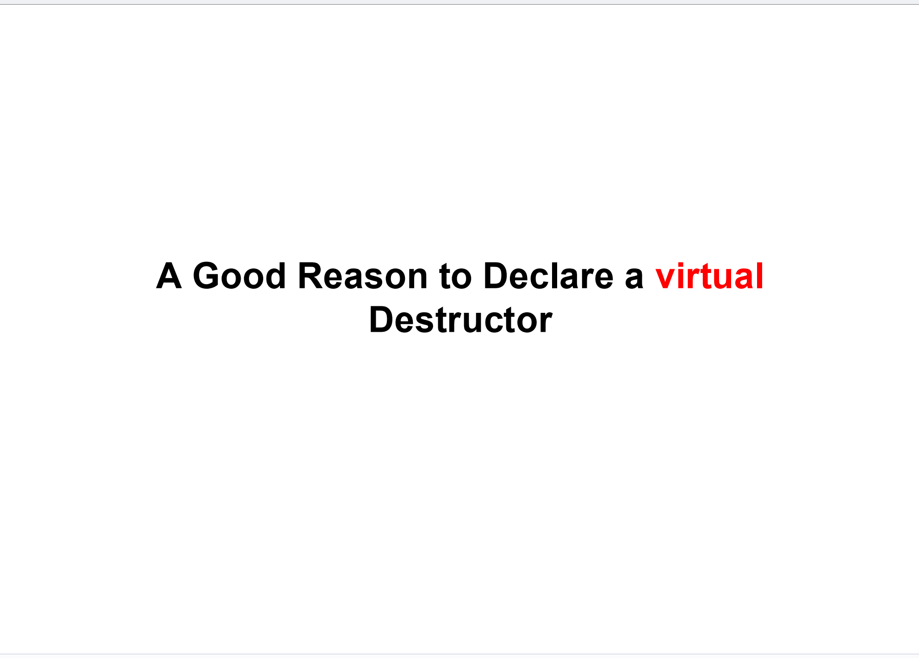

Slide 29
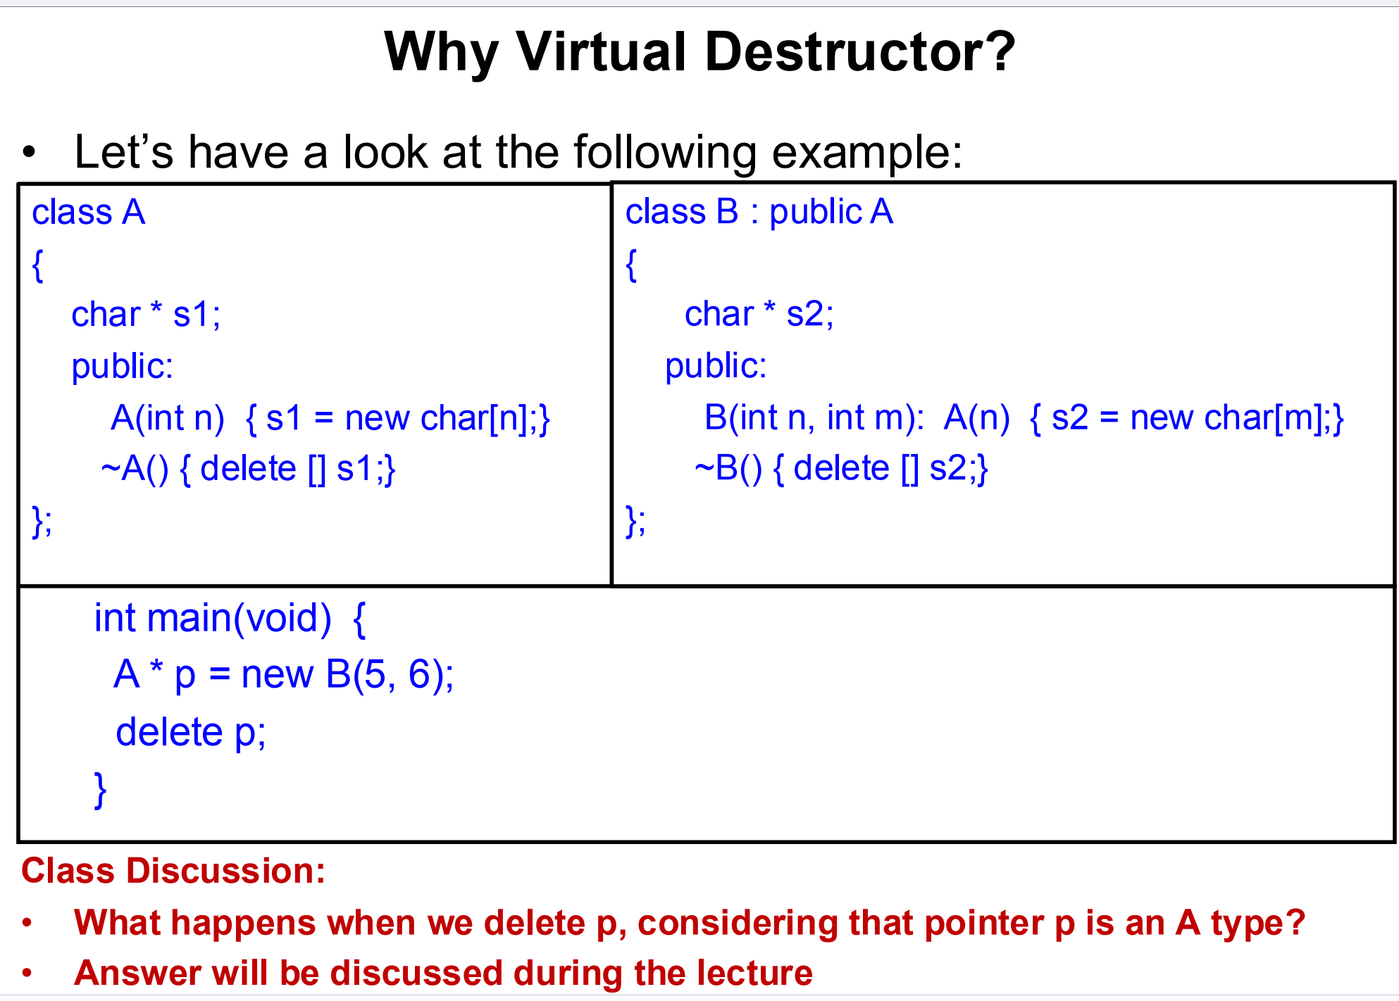

Slide 30
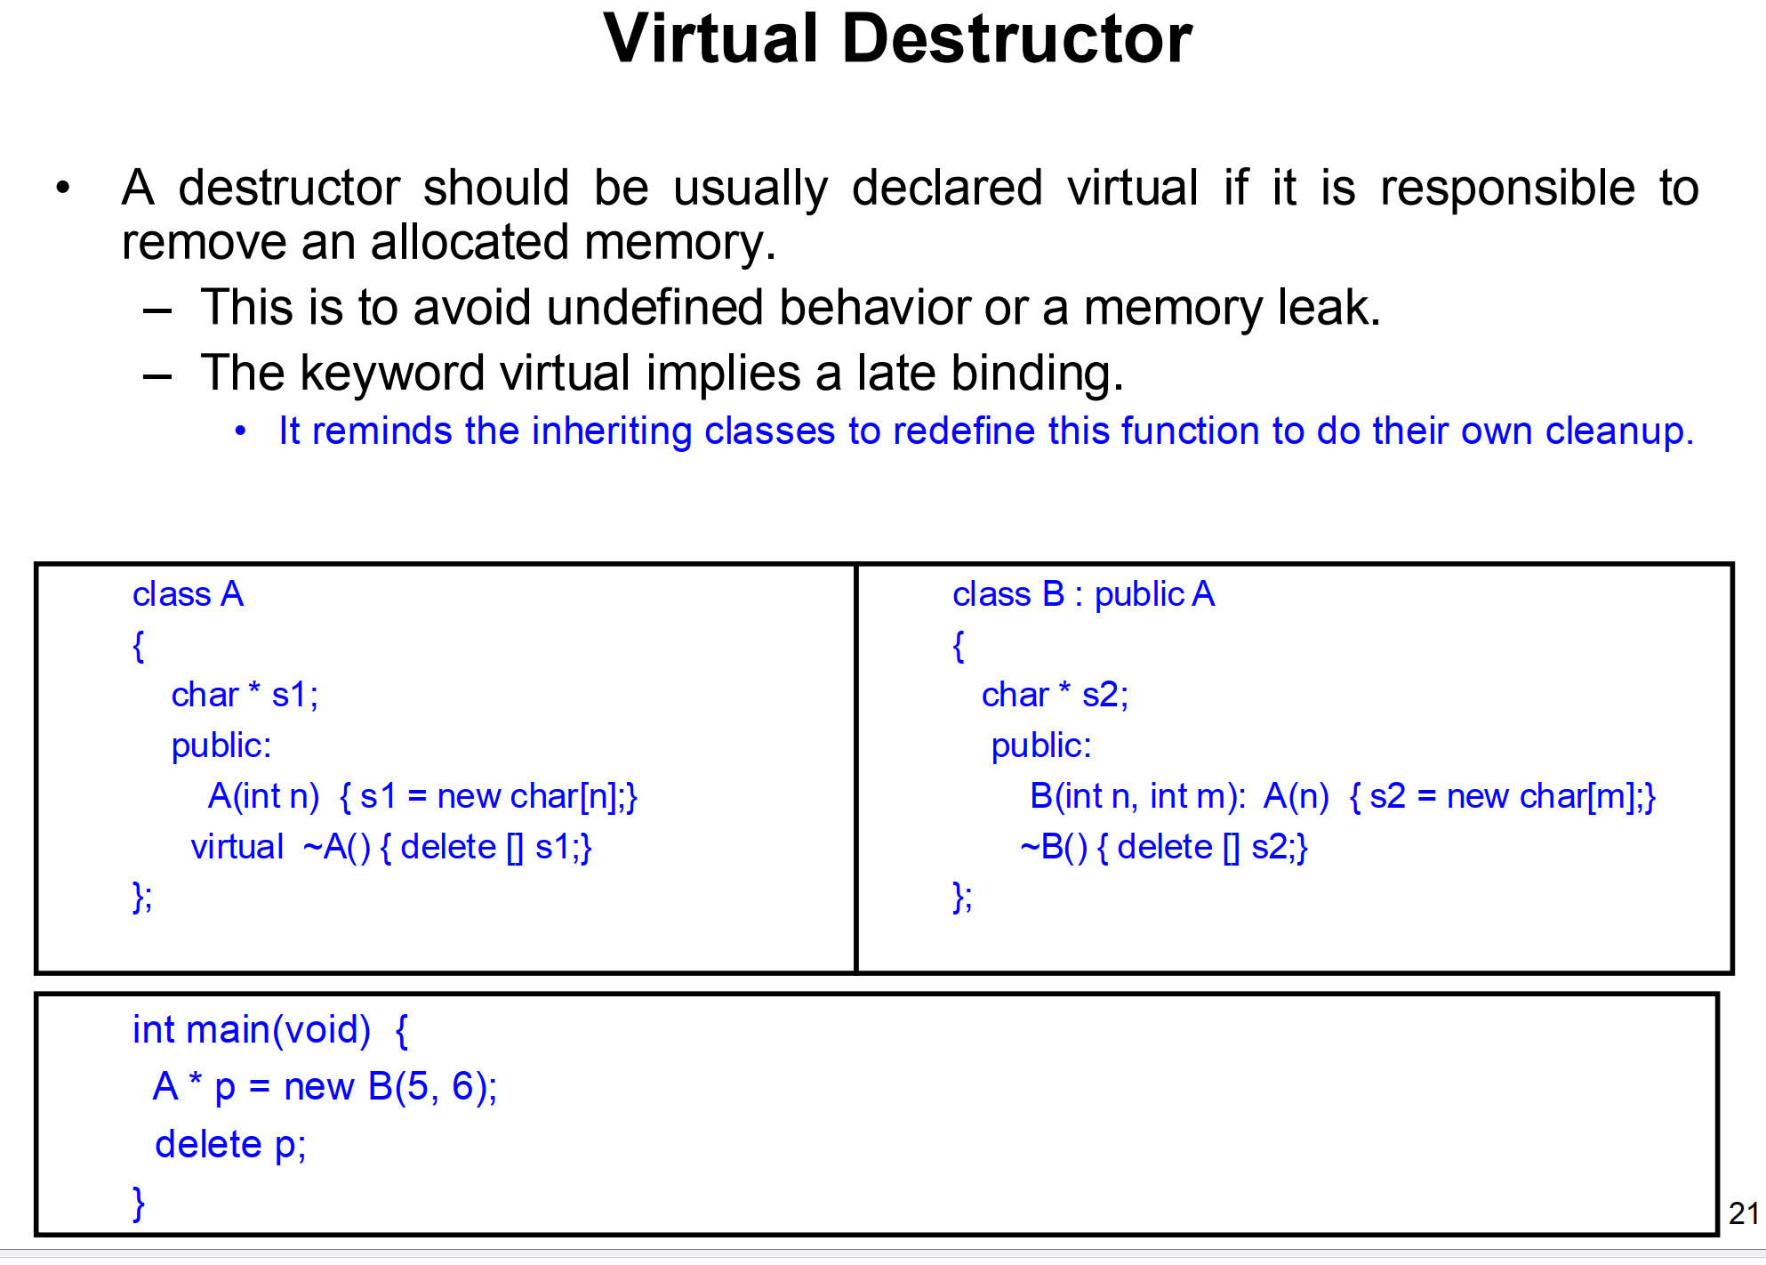

Slide 31
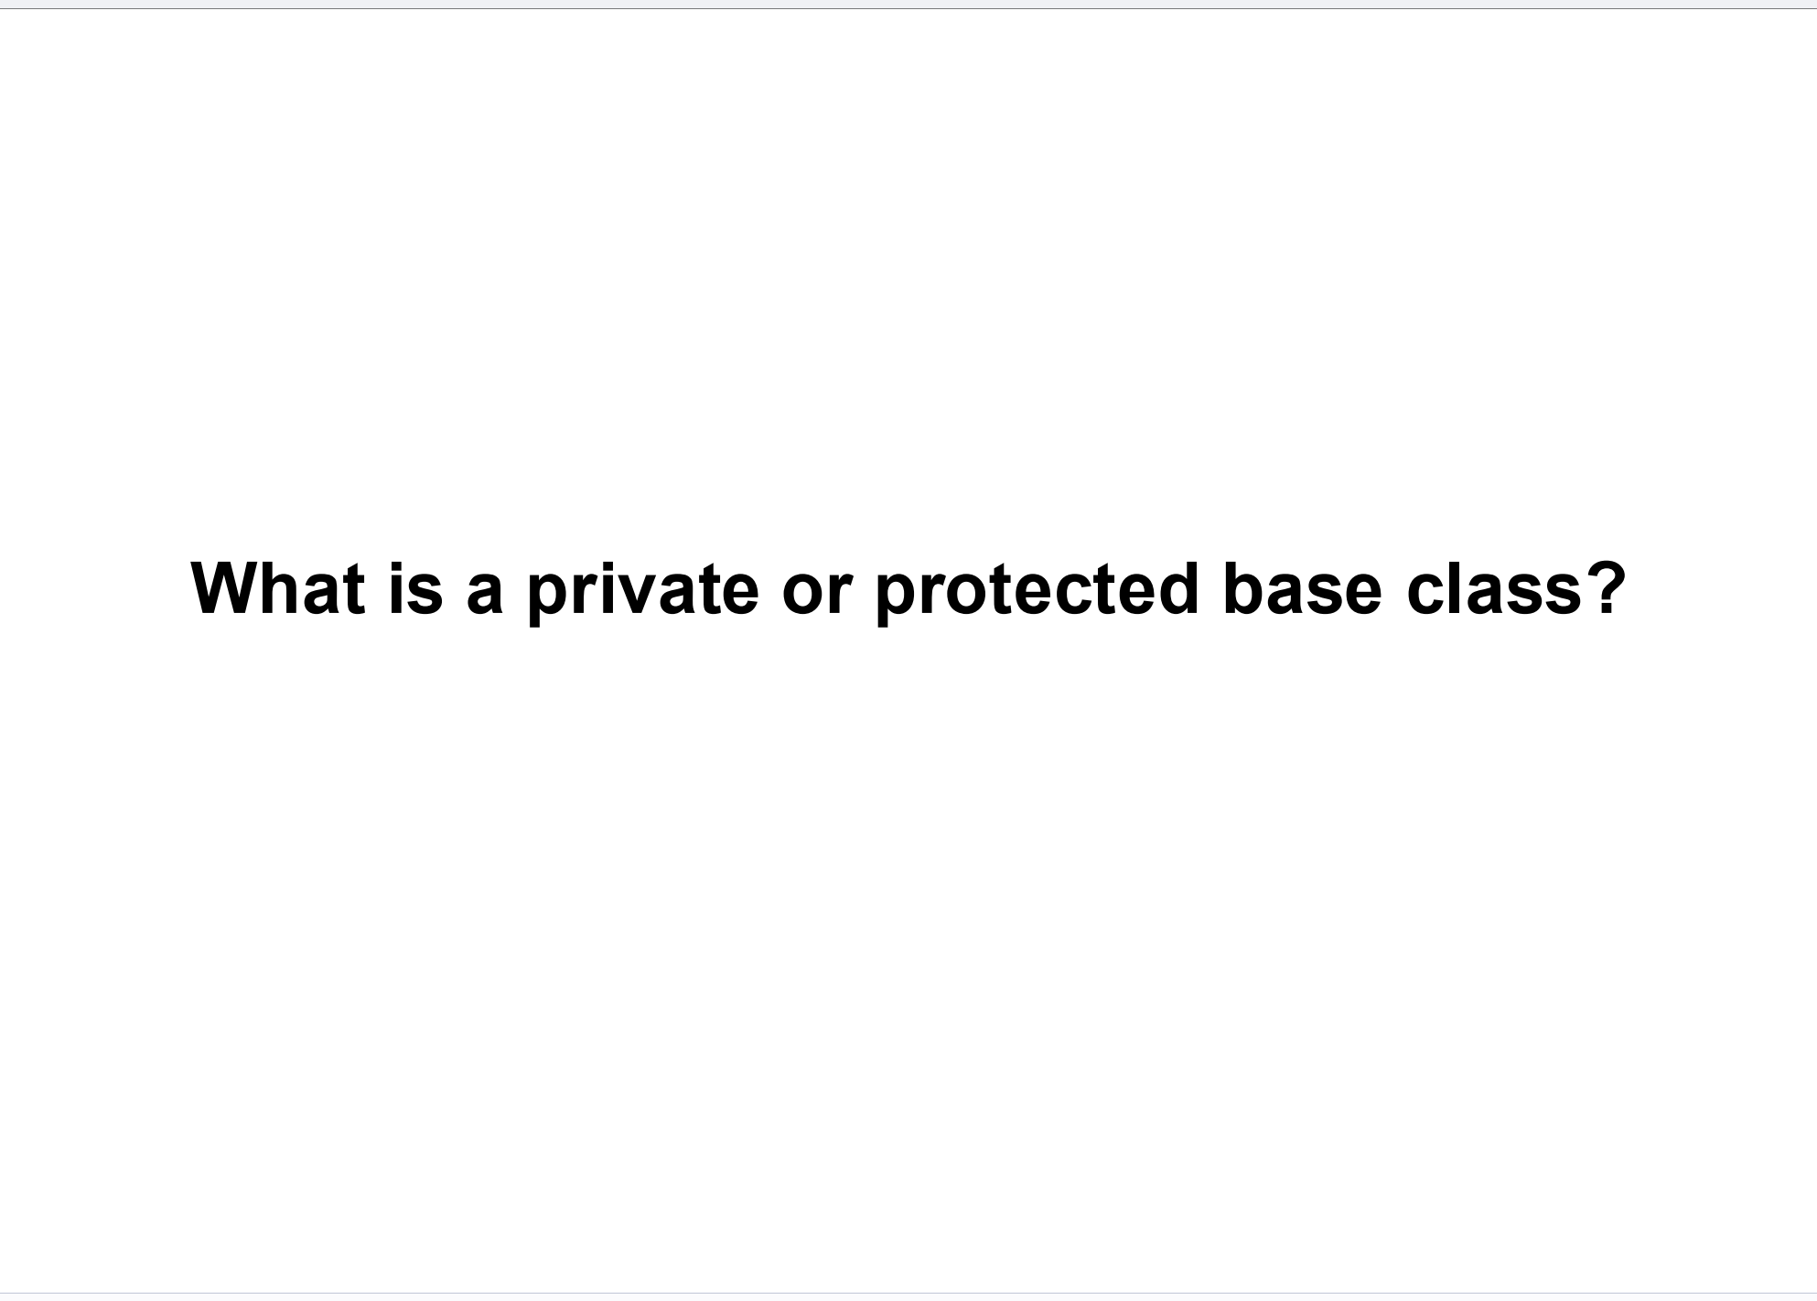

Slide 32
Public Base Class Inheritance
class Base {
public:
int publicVar;
protected:
int protectedVar;
private:
int privateVar;
};
class Derived : public Base {
// publicVar is public in Derived
// protectedVar is protected in Derived
// privateVar is inaccessible in Derived
};

Slide 33
Protected Base Class Inheritance
class Dog : protected Animal {
public:
void bark() {
speak(); // Can access speak() because it is now protected in Dog
}
};
// Base class (Animal)
class Animal {
public:
void speak() {
// Public method
// Becomes protected in Dog
}
protected:
int age;
};
int main() {
Dog myDog;
// myDog.speak(); // Error: speak() is protected in Dog
myDog.bark(); // Valid: Can call Dog's public method
}

Slide 34
Private Base Class Inheritance
// Base class (Animal)
class Animal {
public:
void speak() {
// Public method
// Becomes private in Dog
}
protected:
int age; // Becomes private in Dog
};
class Dog : private Animal {
public:
void bark() {
speak(); // Can access speak() because it's private within Dog
age = 5; // Can access protected member because it's private in Dog
}
};
int main() {
Dog myDog;
// myDog.speak(); // Error: speak() is private in Dog
myDog.bark(); // Valid: Can call Dog's public method
}

Slide 35
